Slide 1
Finding an ideal location
Christopher m. millett

Slide 2
Location, location, location
The less competition a business has the more likely they are to maximize their revenue
A restaurant with less like-styled cuisine in a neighborhood can flourish assuming there aren’t many like it
Restauranteurs may have an interest in using this methodology

Slide 3
Data acquisition & cleaning
Restaurant cuisine, ratings, and names scraped from Foursquare API
Data on boroughs in NYC, neighborhoods, latitudes and longitudes, scraped from https://cocl.us/new_york_dataset
Geospace data to define borough boundaries scraped from https://data.cityofnewyork.us/City-government/borough-boundaries/tqmi-j8zn
In total there were 306 neighborhoods in New York City

Slide 4

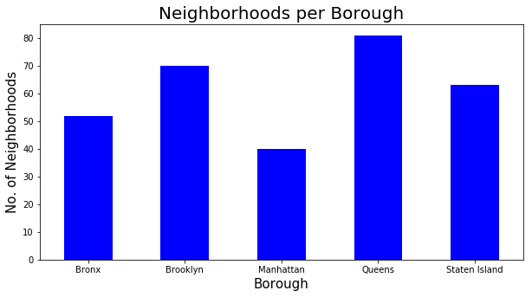
Neighborhoods in NYC
It is clear that Queens has the highest number of neighborhoods
Manhattan has the least amount of neighborhoods
Do the number of neighborhoods correlate to the number of Italian restaurants?

Slide 5
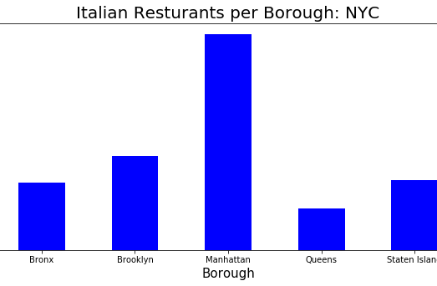
Italian restaurants per borough
Manhattan has the most Italian restaurants
Queens has the least
Where would you open an Italian restaurant?

Slide 6
Queens!
Since Queens has the smallest number of Italian Restaurants in its borough, the question now is in which neighborhood?

Slide 7
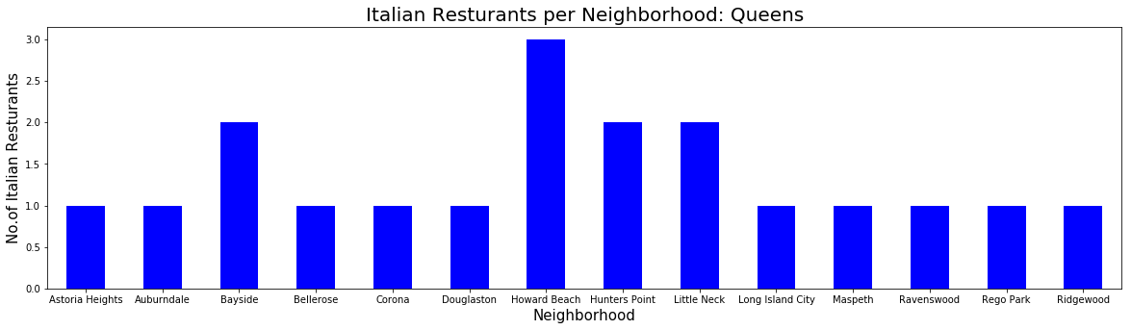
Italian Restaurants per neighborhood: Queens

Slide 8
Which Neighborhood
Howard Beach, Hunters Point, Little Neck, and Bayside have the most Italian restaurants out of all the neighborhoods in Queens
To maximize exposure and potentially dominate the market opening in one of the aforementioned could potentially harm business

Slide 9

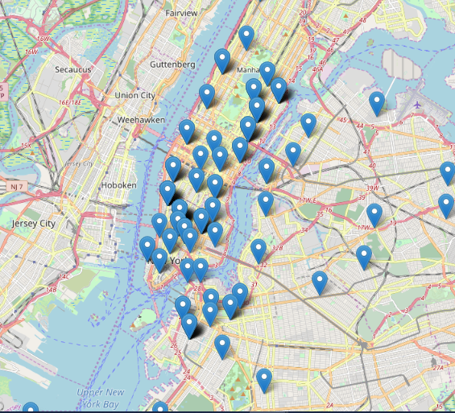
Geospacial visualization
Manhattan is dense with restaurants as shown by the map
Queens due to its large area has less and they are much more sparse

Slide 10
conclusion
Utilized geospacial data and preexisting data sets to determine the ideal NYC borough and neighborhood to establish an Italian restaurant
Accuracy is entirely dependent on Foursquare API regarding restaurants
Can extrapolate this to any style of cuisine

